Slide 1

Content Management System
Blog website
Yannick Wong - Daniel Patularu - Jordan Paille

Slide 2







Content Management Specs
I’m a small company owner that wants to blog to the world to help generate publicity. My needs are small:
• Give me a way to display my blog posts to everyone who comes to my site.
• Give me a way to enter my blog posts so that only I can add them.
Now, I don’t want to have to write HTML in my blog posts. Could you give me a way to write my posts in an editor like Word? I hear there’s something called TinyMCE. Can you hook me up?
What would be nice… I need to categorize my blog posts. And since this is a #hashtag #crazy #world, I probably should have some way to tag my posts with multiple tags as well. ---- I need a way to add static pages. Again, I want the world to view the pages, but only I can write these pages. Remember, I don’t like writing straight HTML at the end of the day, so if you can hook me up with an editor that lets me write rich text and post images, that would be awesome.

Slide 3
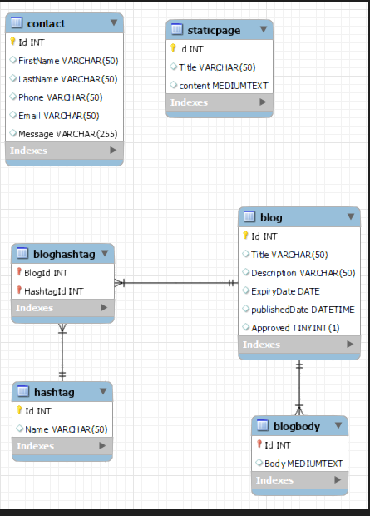
ERD

Slide 4
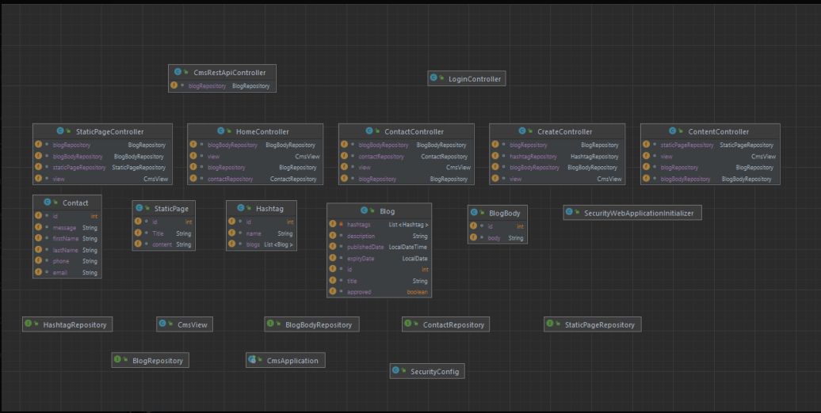
Structure of the project

Slide 5
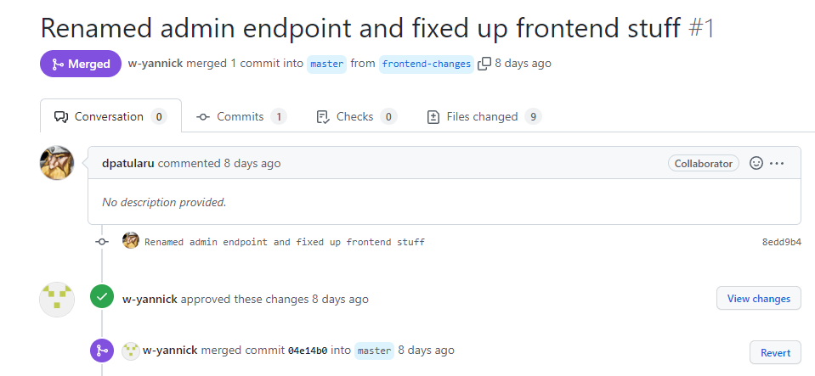
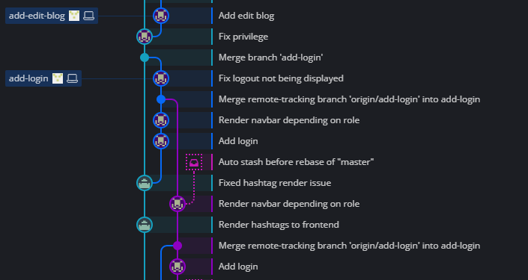
Managing the project
Deadline : 02/08/2022
1 formal meeting/day
Pull request for big changes

Slide 6
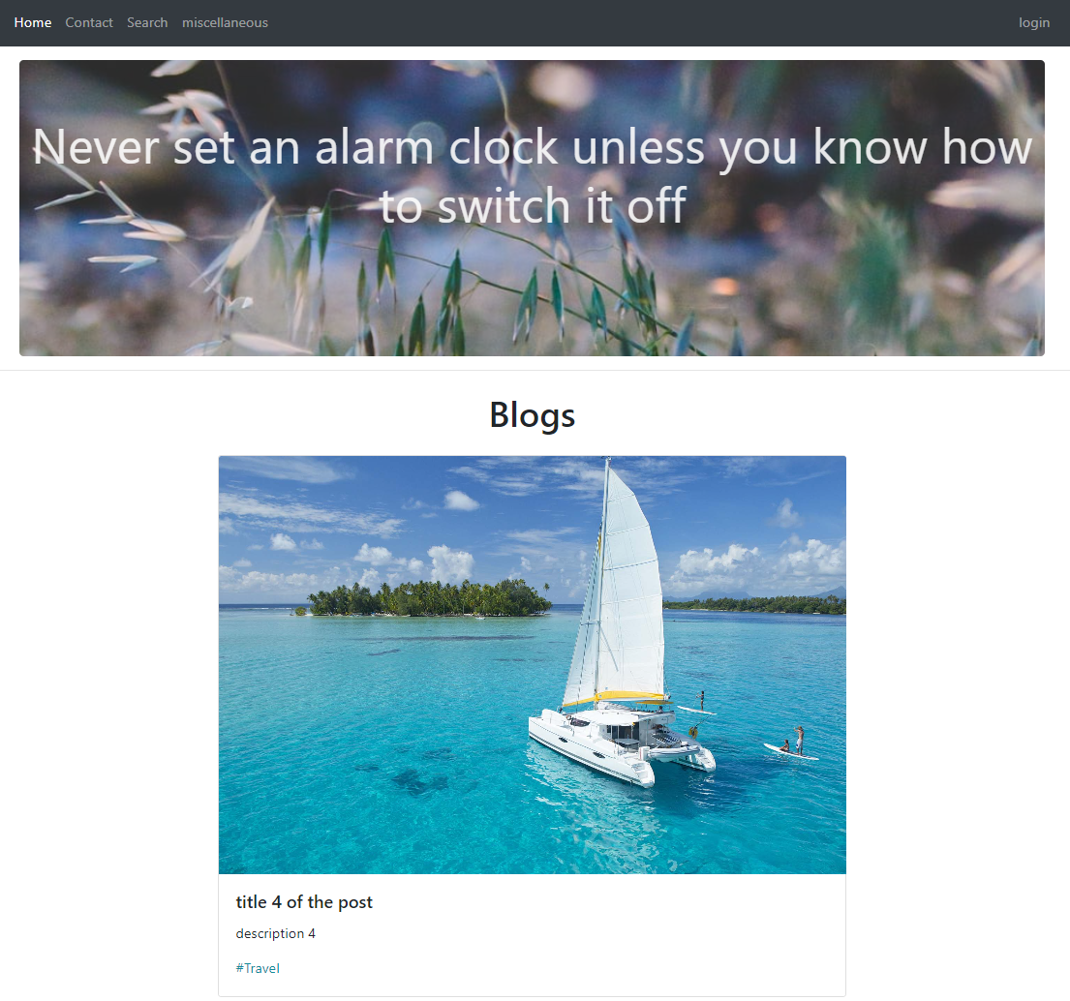
Blog website

Slide 7
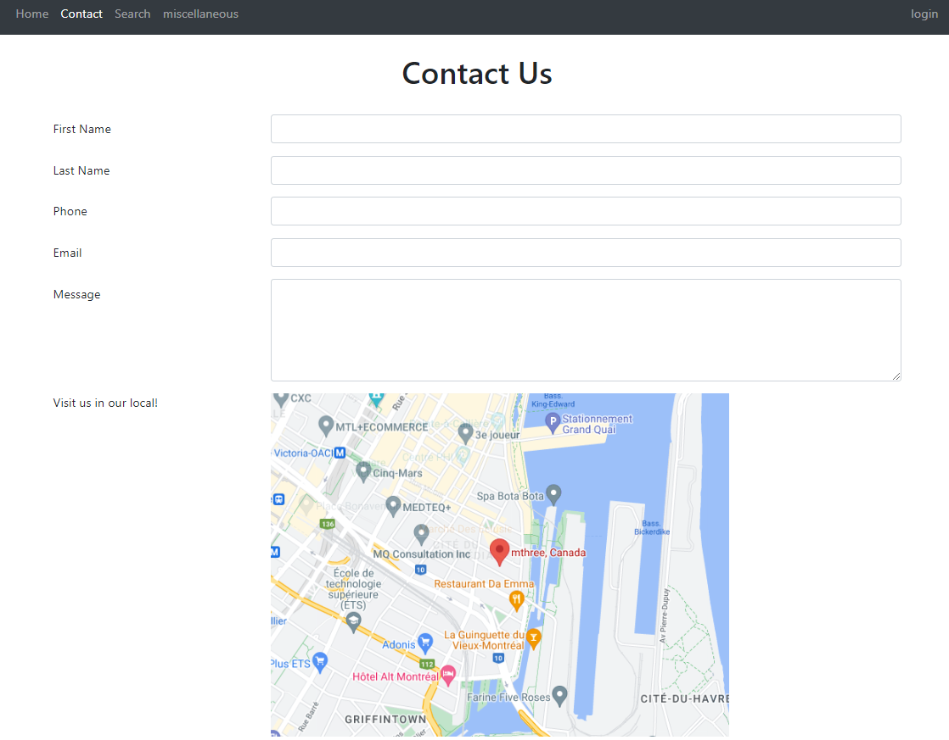

Slide 8
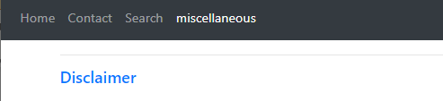
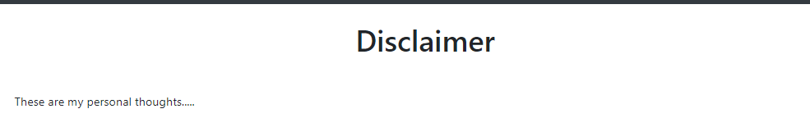

Slide 9
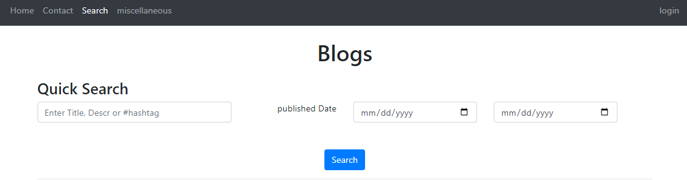

Slide 10
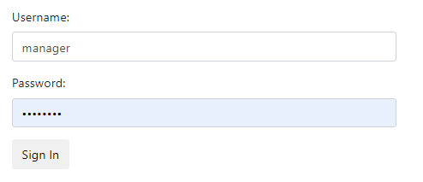
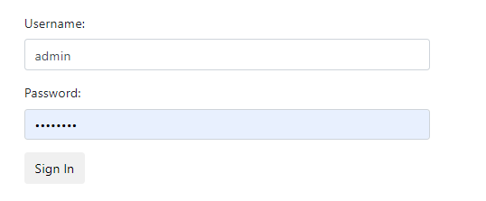
Login
Admin
Manager

Slide 11
Manager

Slide 12
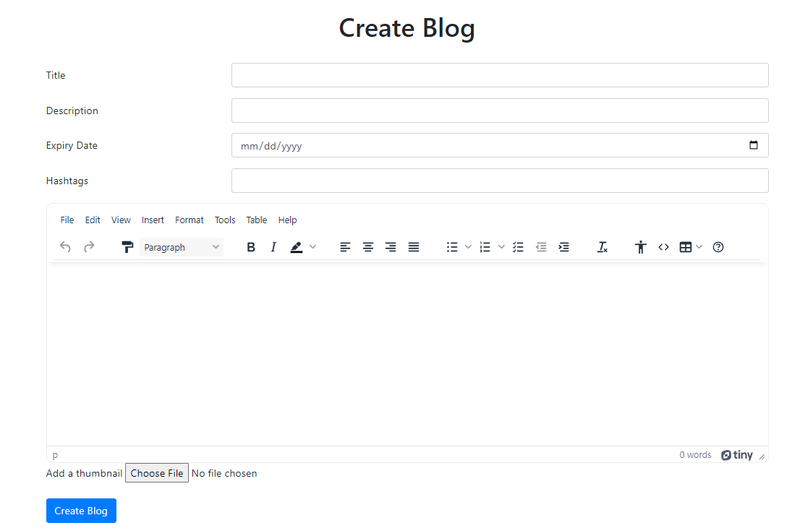

Slide 13
Admin

Slide 14
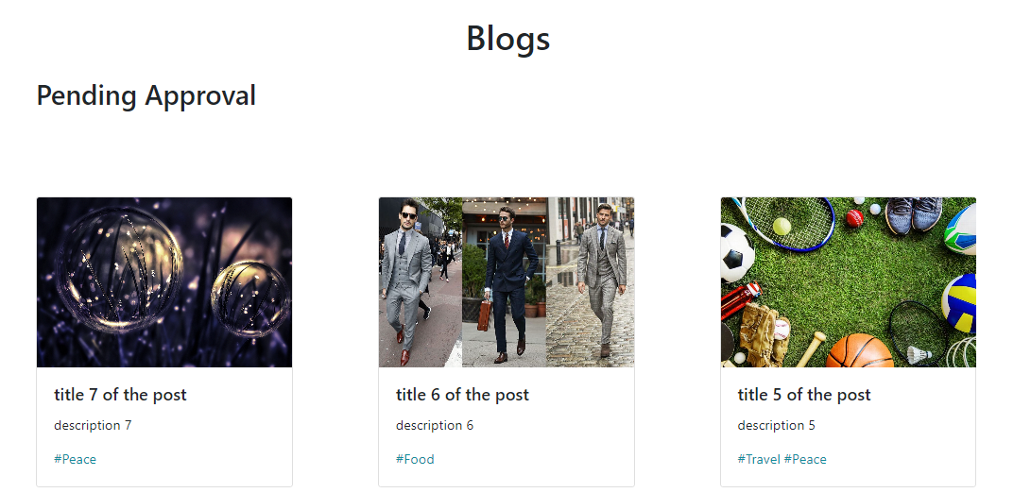

Slide 15
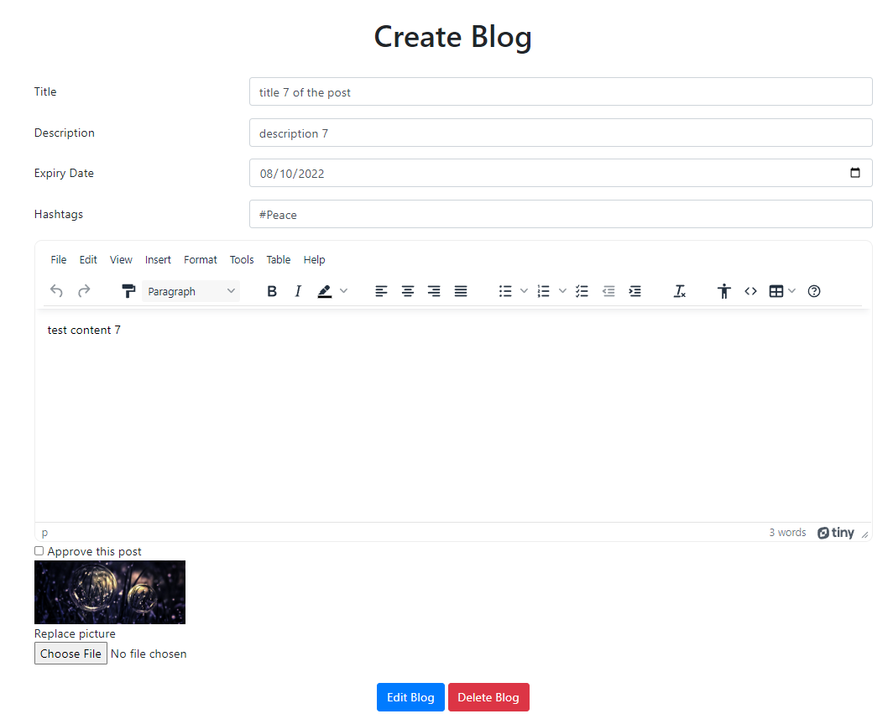

Slide 16
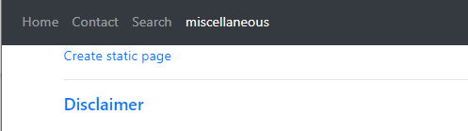
Static pages

Slide 17
